Slide 1
Chapter 6
Index Structures for Files
Chapter 6

Slide 2
Indexes
Indexes are additional auxiliary access structures with typically provide either faster access to data or secondary access paths without effecting the physical storage of the data.
They are based on indexing field(s) that are used to construct the index.
Chapter 6

Slide 3
Types of Indexes
Single-Level Indexes
  Primary
  Secondary
  Clustering
Multi-Level Indexes
  ISAM
  B Trees
  B+ Trees
Chapter 6
Notes:
ISAM Indexed Sequential Access Method

Slide 4
Single Level Indexes
A Primary Index is specified on the ordering key field where each tuple has a unique value.
A Clustering Index is specified on the ordering key field where each tuple DOES NOT have a unique value in that field.
A Secondary Index is specified on a NON-ORDERING Field of the file.
Chapter 6

Slide 5
Primary Indexes
A Primary Index is constructed of two parts: The first field is the same data type of the primary key of a file block of the data file and the second field is file block pointer.
The Anchor Record or Block anchor is the first record in a file block. This is where the value for the first field of the primary index come from along with the respective address of that block.
Chapter 6
Notes:
Mention that this is a sparse index Vs a dense index which has an entry for every key search value.

Slide 6
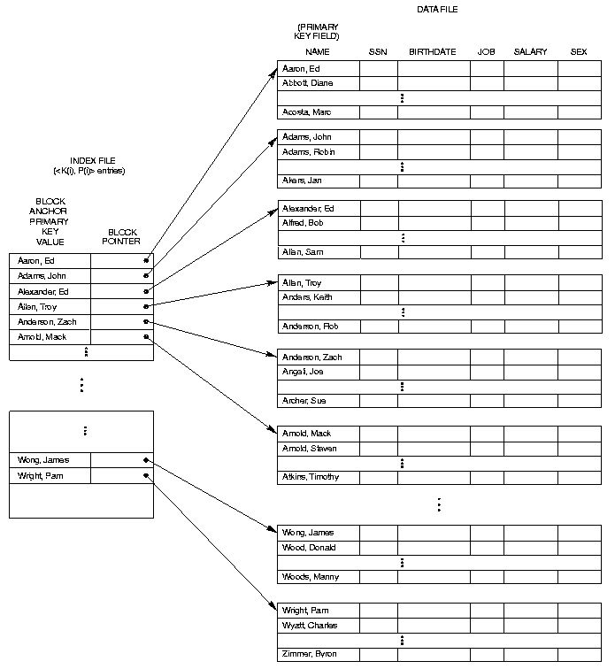
Chapter 6

Slide 7
How to Efficiently Handle Insertions & Deletions when all the blocks FULL?
Chapter 6

Slide 8
Clustering Indexes
Clustering Indexes are used when the ordering index is not a field where each value is unique.
An entry in the clustering index is composed of a SINGLE entry for each distinct value in the clustering field and its respective file block pointer.
Chapter 6

Slide 9
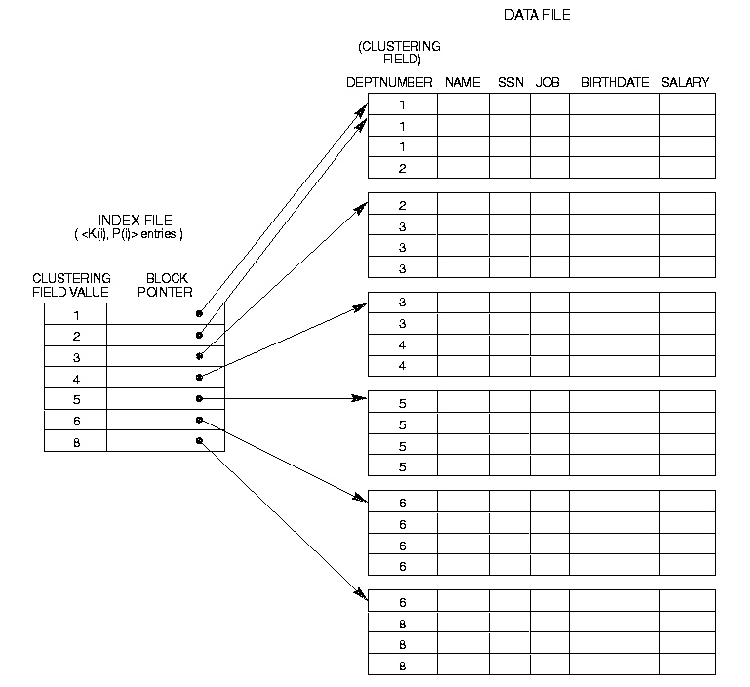
Chapter 6

Slide 10
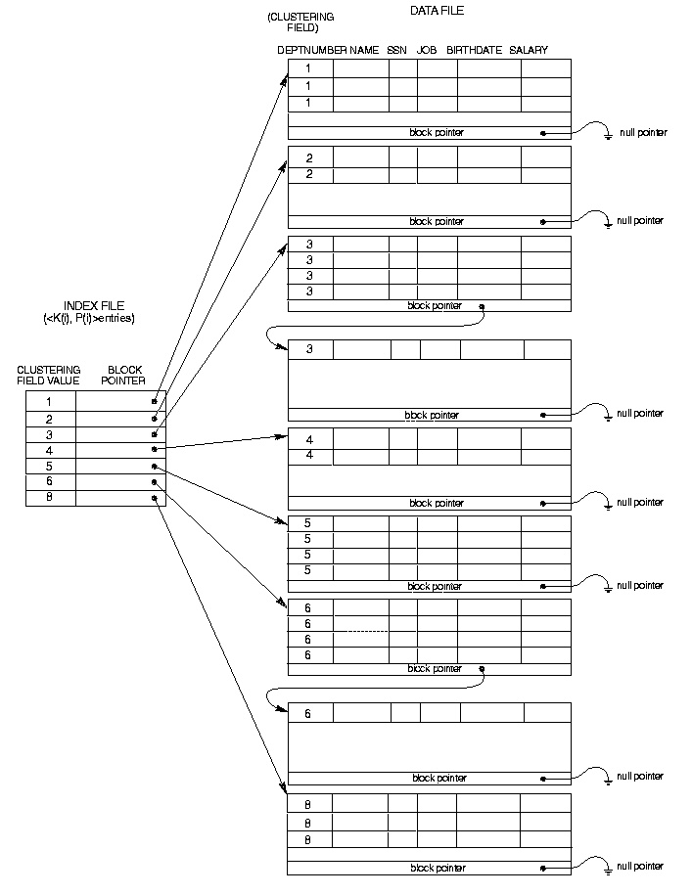
Chapter 6

Slide 11
Secondary Indexes
A Secondary Index is an ordered file with two fields. The first is of the same data type as some nonordering field and the second is either a block or a record pointer.
If the entries in this nonordering field must be unique this field is sometime referred to as a Secondary Key. This results in a dense index.
Chapter 6

Slide 12
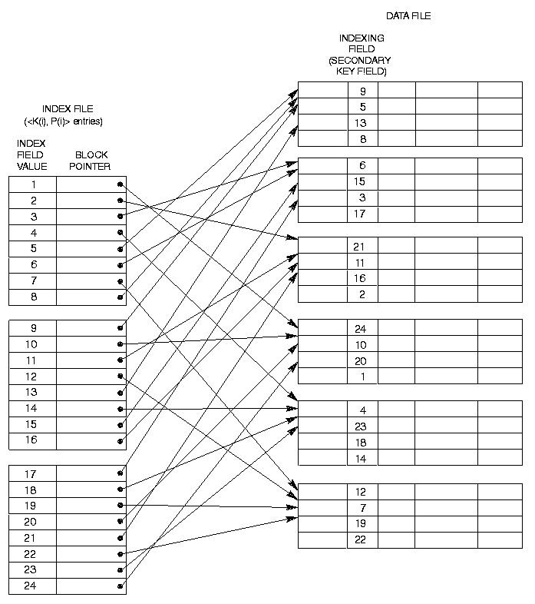
Chapter 6

Slide 13
Secondary Index on Non-Key Field
Since there is no guarantee that the value will be unique the previous index method will not work.
  Option 1: Include index entries for each record. This results in multiple entries of the same value.
  Option 2: Use variable length records with a pointer to each block/record with that value.
  Option 3: Have the pointer; point to a block or chain of blocks that contain pointers to all the blocks/records that contain the field value.
Chapter 6

Slide 14
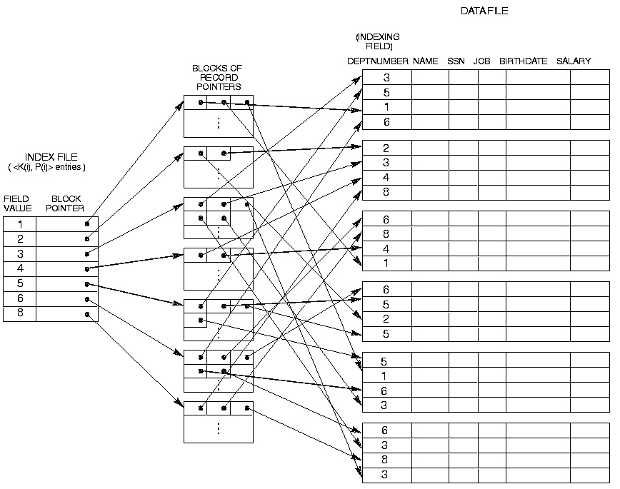
Chapter 6

Slide 15
Multilevel Indexes
A Multilevel Index is where you construct an Second- Level index on a First-Level Index. Continue this process until the entire index can be contained in a Single File Block.
This allows much faster access than binary search because at each level the size of the index is reduced by the fan out factor. Rather just by 2 as in binary search.
Chapter 6

Slide 16
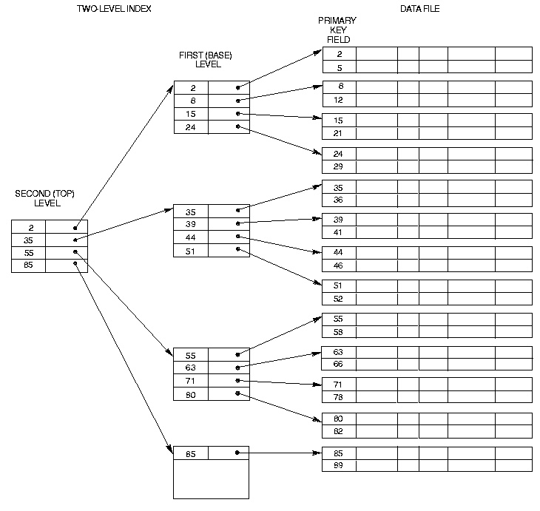
Chapter 6

Slide 17
Multilevel Indexes Using Search Trees, B-Trees & B+ Trees
A Search Tree of order p differs from a Multilevel Index in that each node contains a most p - 1 search values and p pointers.
There is no requirement that the Search Tree be Balanced.
Chapter 6

Slide 18
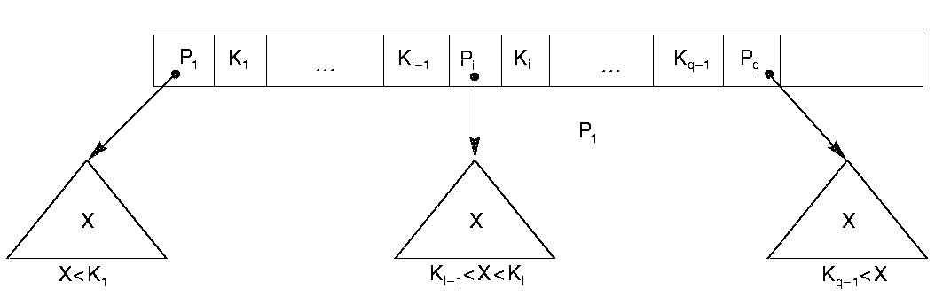
Chapter 6

Slide 19
B-Trees
B-Trees address the problems with Search Trees in that they have the additional constraint that they be balanced and they contain pointers to data records.
Each B-Trees is made up of at most P tree pointers and P-1 field values K and data pointers Pr.
Chapter 6

Slide 20
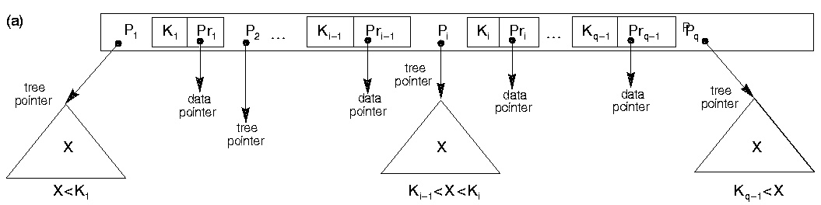
Chapter 6

Slide 21
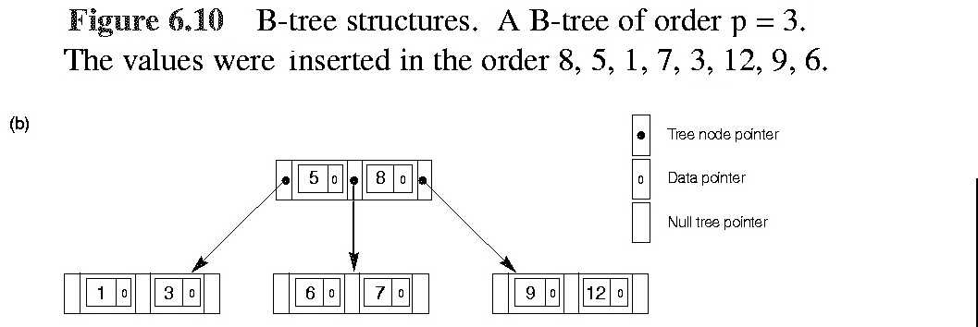
Chapter 6

Slide 22
B-Tree Rules
<P₁, <K₁, Pr₁>, . . . , P_{q-1}, <K_{q-1}, Pr_{q-1}>, P_{q}>
Within each node K₁ < K₂ < . . .< K_{q-1}
For each search value X in the subtree pointed to by P_{i} the following hold true:
When i = 1 : X < K_{i}
When 1< i < q : K_{i-1} < X < K_{i}
When i = q -1: K_{i} < X
Chapter 6

Slide 23
B-Tree Rules (con’t)
Each node has at most p tree pointers.
Each node, except the root and leaf nodes, has at least ⎡(p/2) ⎤ tree pointers. The root node has at least two tree pointers unless it is the only node in the tree.
A node with q tree pointers, q ≤ p, has q -1 search key field values.
All leaf node are at the same level and all their tree pointers are null.
Chapter 6

Slide 24
Example 4
Search Field V=9 bytes
Disk Block B=512 bytes
Record Pointer P_{r} = 7 bytes
Block Pointer P = 6 bytes
Compute the number of block pointers p that can be contained in one block where siblings are linked.
(p*P) + ((p-1) *(P_{r}+V)) + P < B
Chapter 6

Slide 25
Example 5
Non-ordering search field.
Each node is 69% full in B-Tree
Based on Example 4 compute the average fan-out factor compute the number of nodes, data entries and Block pointers (Root to Level 3).
Chapter 6

Slide 26
B+ - Trees
Unlike B-Trees B+ - Trees are constructed of two different nodes:
Internal Nodes where:
  <P₁, K₁, . . . , P_{q-1}, K_{q-1},, P_{q}>
  For each internal node K₁ < K₂ < . . . < K_{q-1}
Chapter 6

Slide 27
  For all search field values X pointed by P_{i}
  When i = 1 : X < K_{i}
  When 1< i < q : K_{i-1} < X ≤ K_{i}
  When i = q -1: K_{i} < X
  Each Internal node has at most p tree pointers.
  Each node, except the root and leaf nodes, has at least ⎡(p/2) ⎤ tree pointers. The root node has at least two tree pointers if it is an internal node.
  An internal node with q pointers, q≤p, has q-1 search field values.
Chapter 6

Slide 28
B+-Tree Leaf Nodes
Each leaf is of the form
<<K₁, Pr₁>, <K₂,Pr₂>, … , <K_{q-1}, Pr _{q-1}>, P_{next}>
Within each leaf node, K₁ < K₂ <…<K_{q-1}
Each Pr_{i} is a data pointer that points to the block/record that contains K_{i}.
Each Leaf Node has at least ⎡(p/2) ⎤ values.
All leaf nodes are at the same level.
Chapter 6

Slide 29
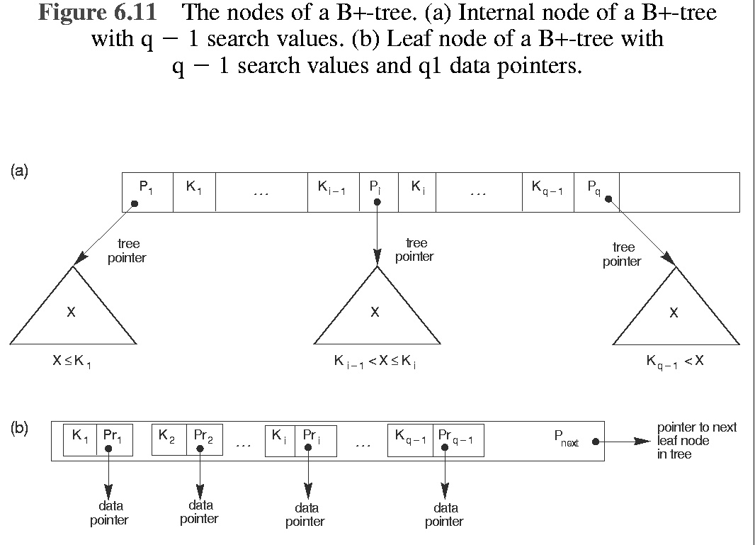
Chapter 6

Slide 30
Computing p & p_{leaf} for B+ Trees
Calculate p for an internal & leaf node:
  V = 9 bytes
  P_{r} = 7 bytes
  P = 6 bytes
  (p * 6) + ( (p - 1) * 9) < 512
  (p_{leaf} * (P_{r} + V)) + 6 < 512
Chapter 6

Slide 31
Insert record r=(k,Pr) with key K in B+ Tree
begin
locate leaf n to which K belongs;
if n has < Pleaf entries then
insert (K, Pr) in proper order into n, and EXIT
else
‘temporarily’ insert (K,Pr) in proper order into n;
allocate a new leaf new;
keep first ⎡(Pleaf +1)/2⎤ entries of n in n;
assign the remaining entries to new;
recursively insert new as a child of the parent of n. To split an internal node that overflows use P instead of Pleaf
Chapter 6

Slide 32
Chapter 6

Slide 33
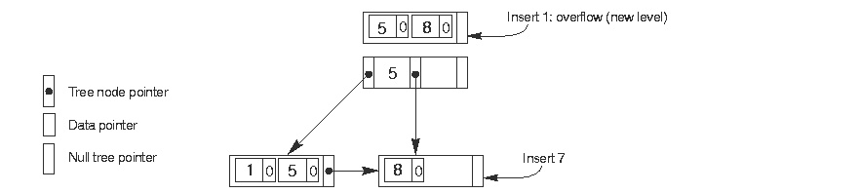
Chapter 6

Slide 34
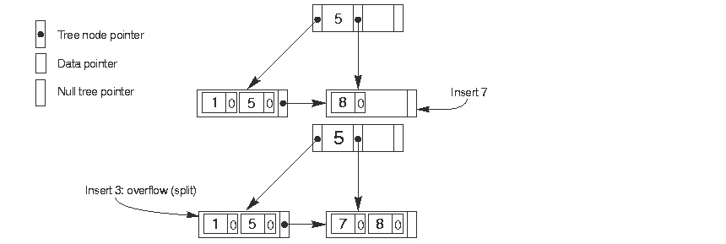
Chapter 6

Slide 35
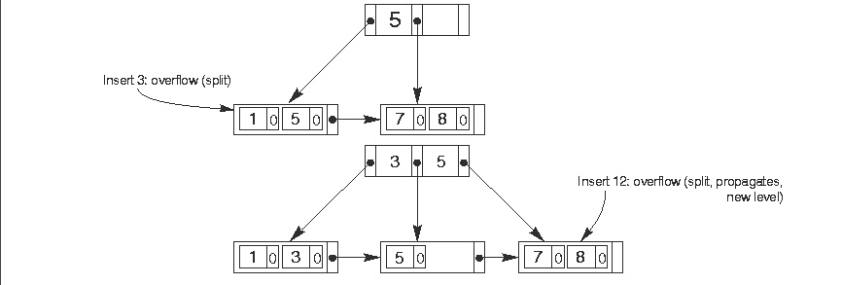
Chapter 6

Slide 36
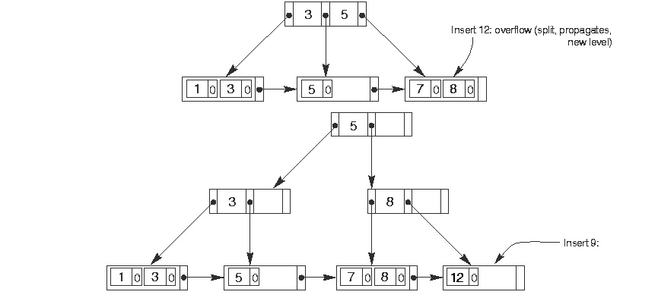
Chapter 6

Slide 37
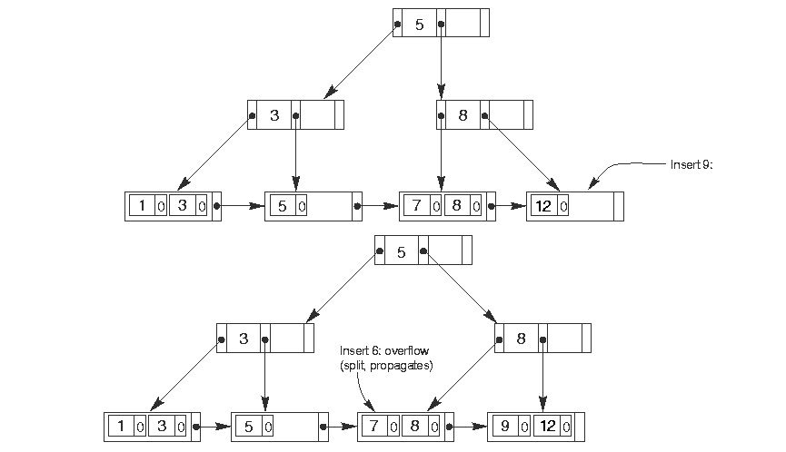
Chapter 6

Slide 38
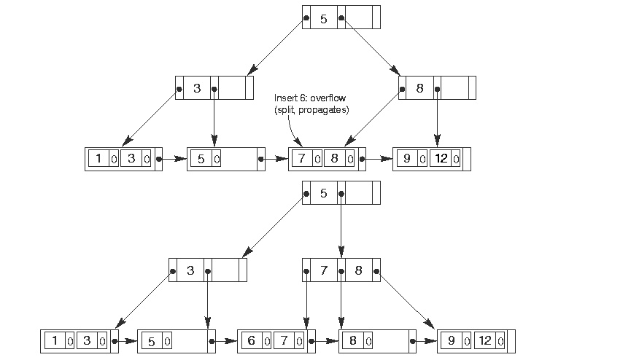
Chapter 6

Slide 39
Delete record r=(k,Pr) with key K in B+ Tree
locate leaf n to which K belongs;
if n has >⎡Pleaf/2⎤ entries then
remove (K,Pr) from n, adjust parents as needed and EXIT
else if left sibling ( if exists) of n has >⎡Pleaf/2⎤ entries
remove (k, Pr) from n and move largest entry of its left sibling to n, adjust parents as needed and EXIT
else if right sibling ( if exists) of n has >⎡Pleaf/2⎤ entries
remove (k, Pr) from n move smallest entry of its left sibling to n, adjust parents as needed and EXIT
Chapter 6

Slide 40
Delete record in B+ Tree (con’t)
else if exist left sibling of n then
remove (k, Pr) from n;
assign remaining entries of n to its left sibling;
recursively delete n;
else
remove (k, Pr) from n;
assign remaining entries of n to its right sibling;
recursively delete n;
Chapter 6

Slide 41
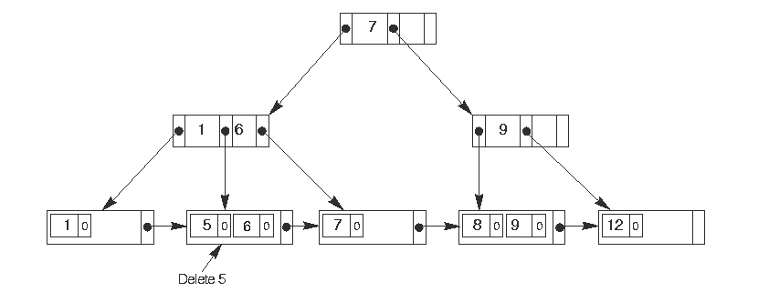
Chapter 6

Slide 42
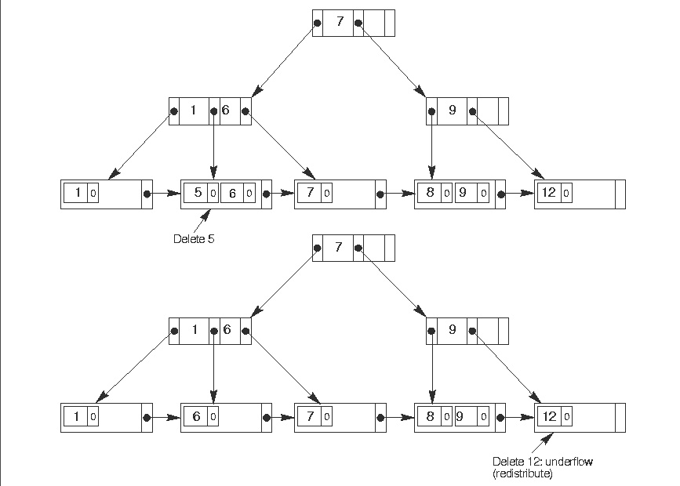
Chapter 6

Slide 43
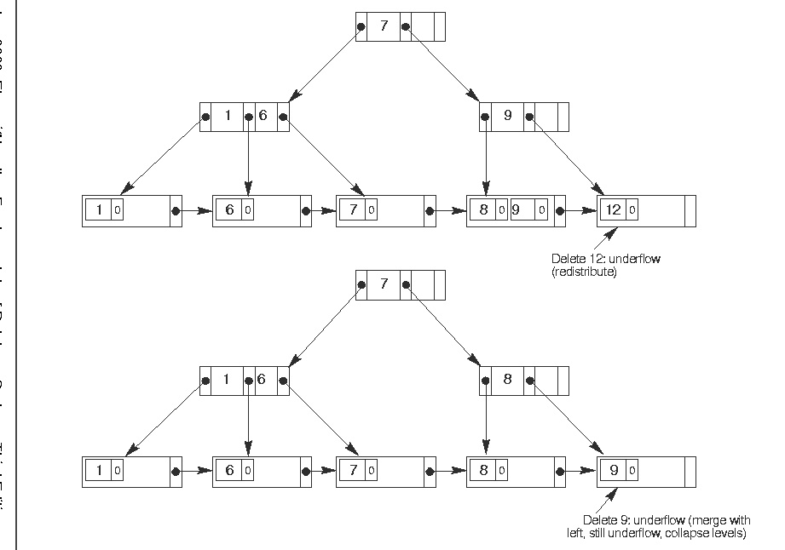
Chapter 6

Slide 44
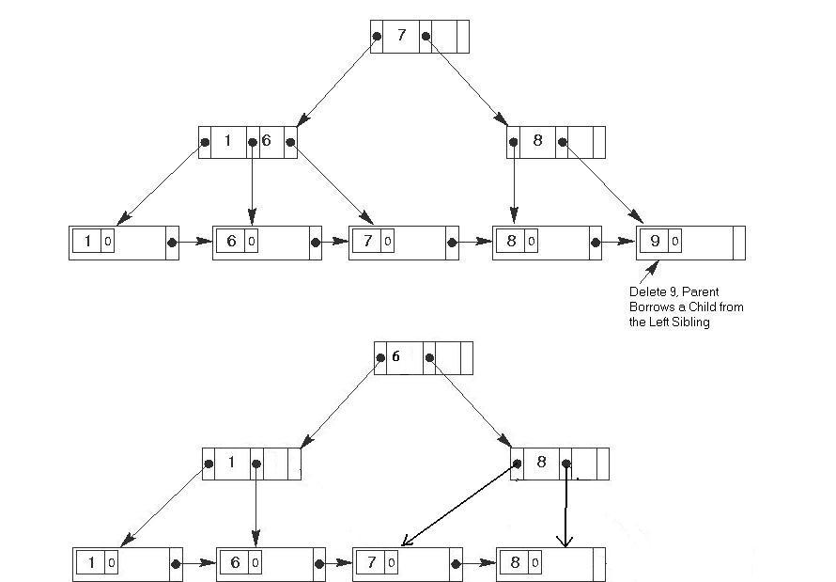
Chapter 6

Slide 45
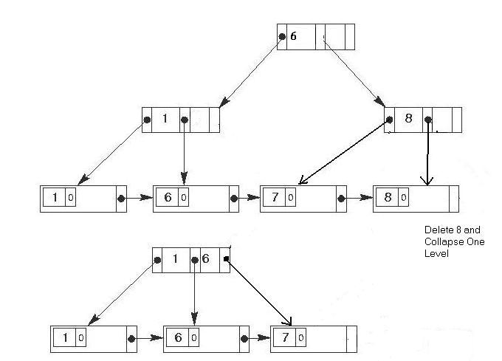
Chapter 6

Slide 46
Indexes On Multiple Keys
Up until now we have limited our discussion to accessing file based on single attributes. Unfortunately, in the real world composite keys exist along with queries on multiple fields and have to be dealt with.
Chapter 6

Slide 47
Accessing Based on Multiple Attribute Conditions
If any of the attributes in the search condition have an index associated with it you may use that index to limit your search.
If more than one of the attributes in the search condition have indexes associated with them you can find the intersection of those indexes to limit your search.
Chapter 6

Slide 48
Creating an Ordered Index on Multiple Attributes
When you create an Ordered Index on multiple attributes; it is constructed on the Order in which the attributes are specified.
This means that if we constructed an index on DNO, SUPERSSN and BDATE in ascending order; first it would be ordered by DNO (1-5). Then within each DNO i.e. 4 they would be ordered by SUPERSSN and so on.
Chapter 6

Slide 49
Partitioned Hashing
Partitioned hashing is an extension of static external hashing that allows access on multiple keys.
It assigns specific fields of the hash address to each attribute so the value of each attribute that makes up the index is hashed to generate that portion of the bit pattern to be used and the combined pattern is assembled.
Chapter 6
Notes:
Main drawback is that it cannot handle range queries of any component attributes.

Slide 50
Grid Files
With Grid Files you create a N-Dimensional array for N attributes. Each attribute is divided into table which will map it to the coordinate of its respective dimension
While this method works well with ranges its overhead can be expensive.
Chapter 6

